Slide 1
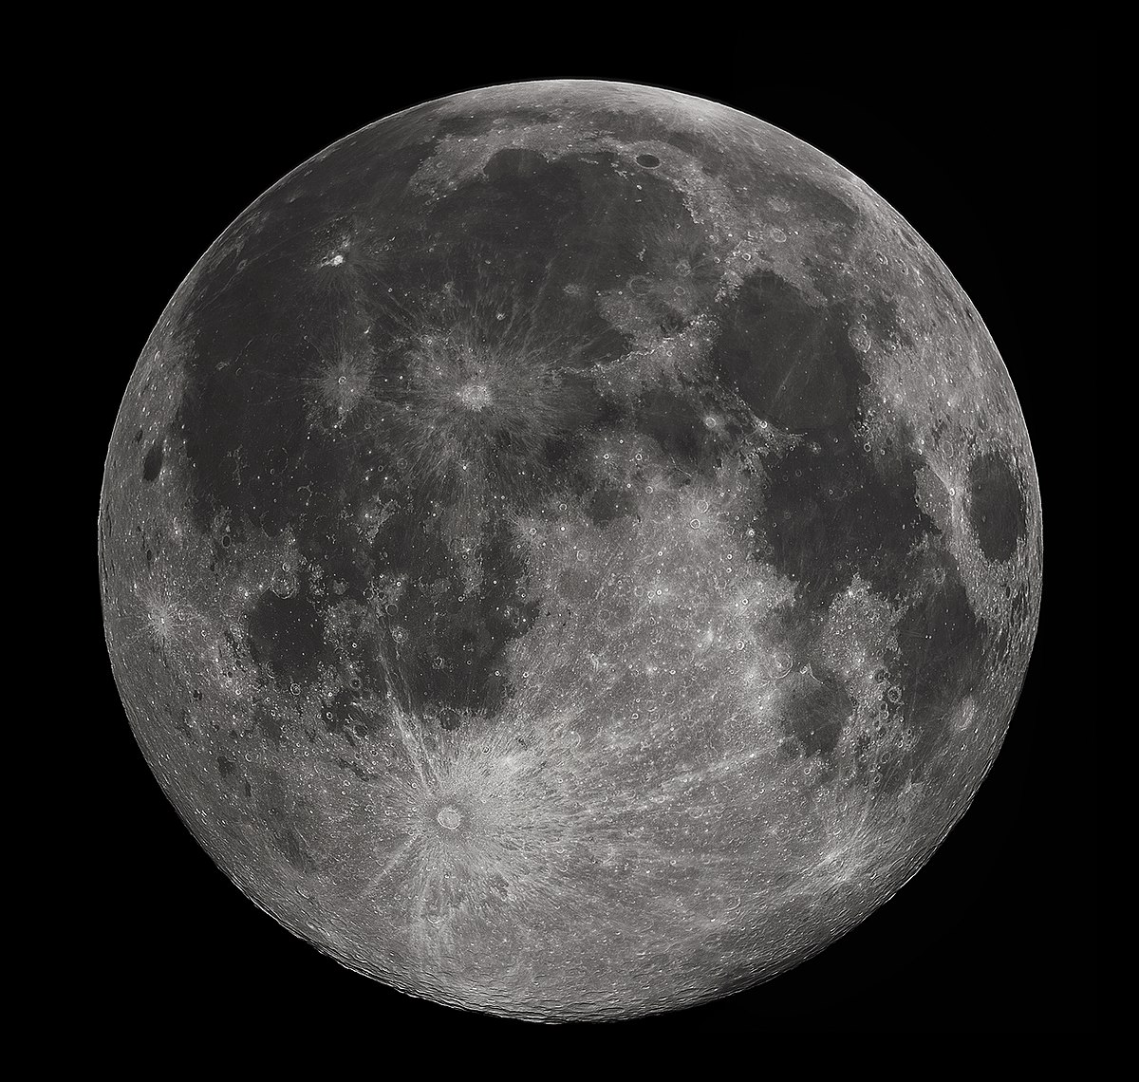
Earth-Moon-Earth
Dwayne Sinclair AB6A, Redondo Beach, CA, USA

Slide 2
BIO
Interest in ShortWave Listening (SWL) since 5 years old. Friends father an Amateur operator Christchurch, New Zealand. Member of “Radio Club” Hillmorton High, Christchurch New Zealand.
SWL Listener for most of my life.
IT Infrastructure Specialist -> Networking, Storage, & Compute
Purchased a Nooelec Dongle… The most expensive $25 I have ever purchased!
Licensed as a Technician and first transceiver was HF. First QSO was 40M CW -> KN6AFP
Upgraded to General/Extra -> NA6US -> AB6A
Station equipment includes Flex Radio and ICOM HF/VHF/UHF/SHF.
Interests are HF DX’ing, Balloons, Portable Satellite Operations, Battleships (NI6BB), and EME.
Astronomy Mounts for Amateur Radio Satellite Tracking
https://www.beyondcli.com/ham/satellite-tracking-using-astronomy-goto-mount/

Slide 3
YouTube - Curious mark and the Stanford dish
https://www.youtube.com/watch?v=Zj3ZuphVxsE

Slide 4
THE JOURNEY to EME on 24GHz
https://www.arrl.org/files/file/Technology/tis/info/pdf/0210028.pdf
July 21, 1960 made the first-ever amateur EME QSO between W1BU and W6HB on 1296MHz.
The first 144 MHz EME QSO was made on April 11, 1964 between W6DNG and OH1NL
W1BU making the first 432 MHz EME contact with KH6UK on May 20 in 1964.
It was not until after many years of work that the first 2304 MHz EME QSO took place between W4HHK and W3GKP on October 19, 1970.
The first 220 MHz EME con- tact took place on March 15, 1970 between W7CNK and WB6NMT (now KG6UH).
A couple of years later the team of W5WAX (now K5SW) and K5WVX (now K5CM) worked the team of WA5HNK and W5SXD on 6 meter EME. Their contact took place on July 30, 1972.
The first 902 MHz EME contact took place on January 22, 1988 between K5JL and WA5ETV.

Slide 5
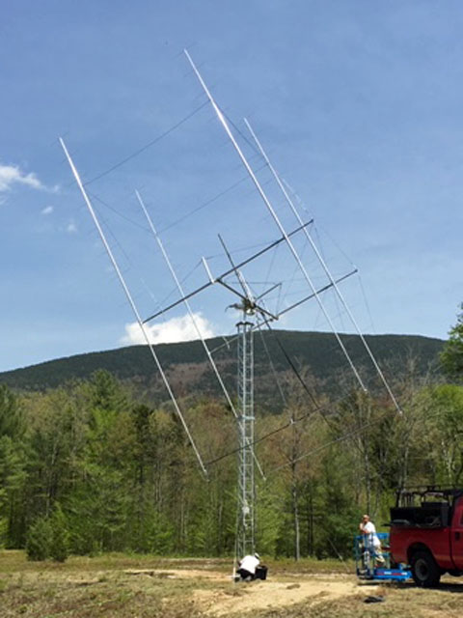
2M EME
https://stationproject.blog/2019/10/21/eme-part1-goals-station-design/
Major Hardware Requirements
Large phased antenna array.
Rotator.
1500W 2M Amplifier.
Real Estate

Slide 6
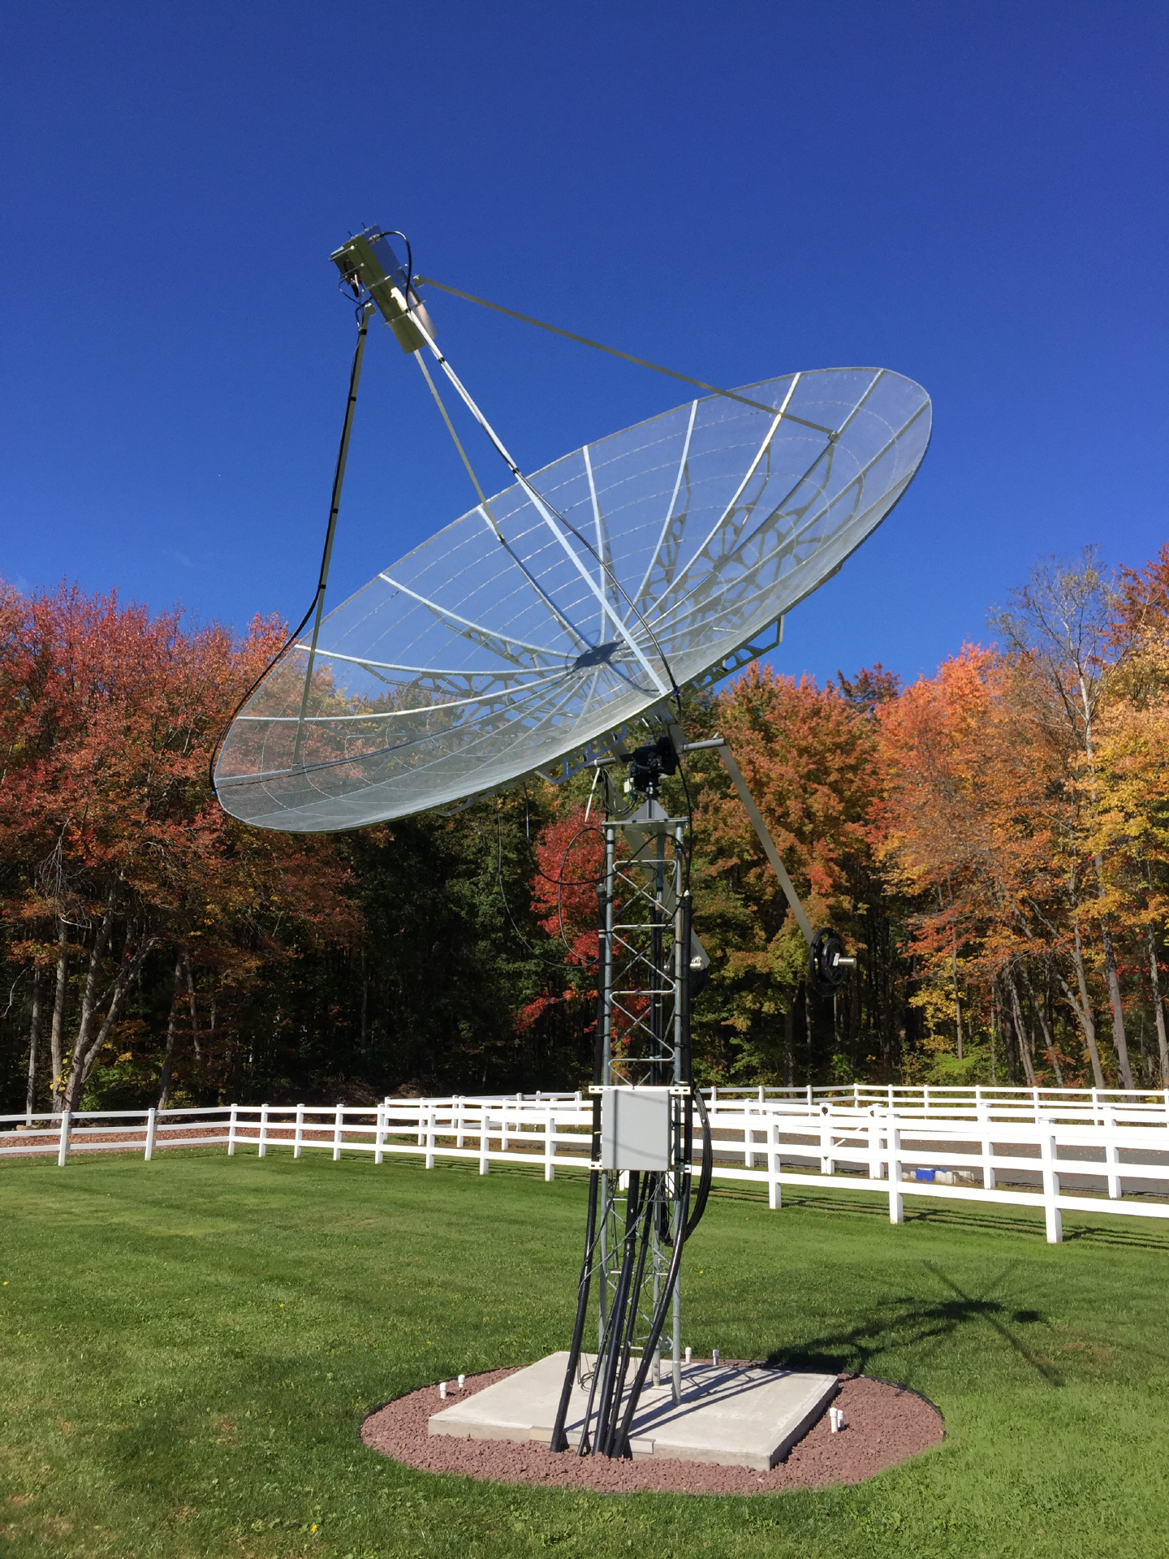
23CM EME
http://www.parelectronics.com/earth-moon-earth.php
Main Hardware Requirements
1.8M-5M Dish Antenna
Rotator, although manual pointing can work for small dishes.
200W-600W 23CM Amplifier.

Slide 7
23CM EME PORTABLE
The perfect portable operation vehicle…

Slide 8
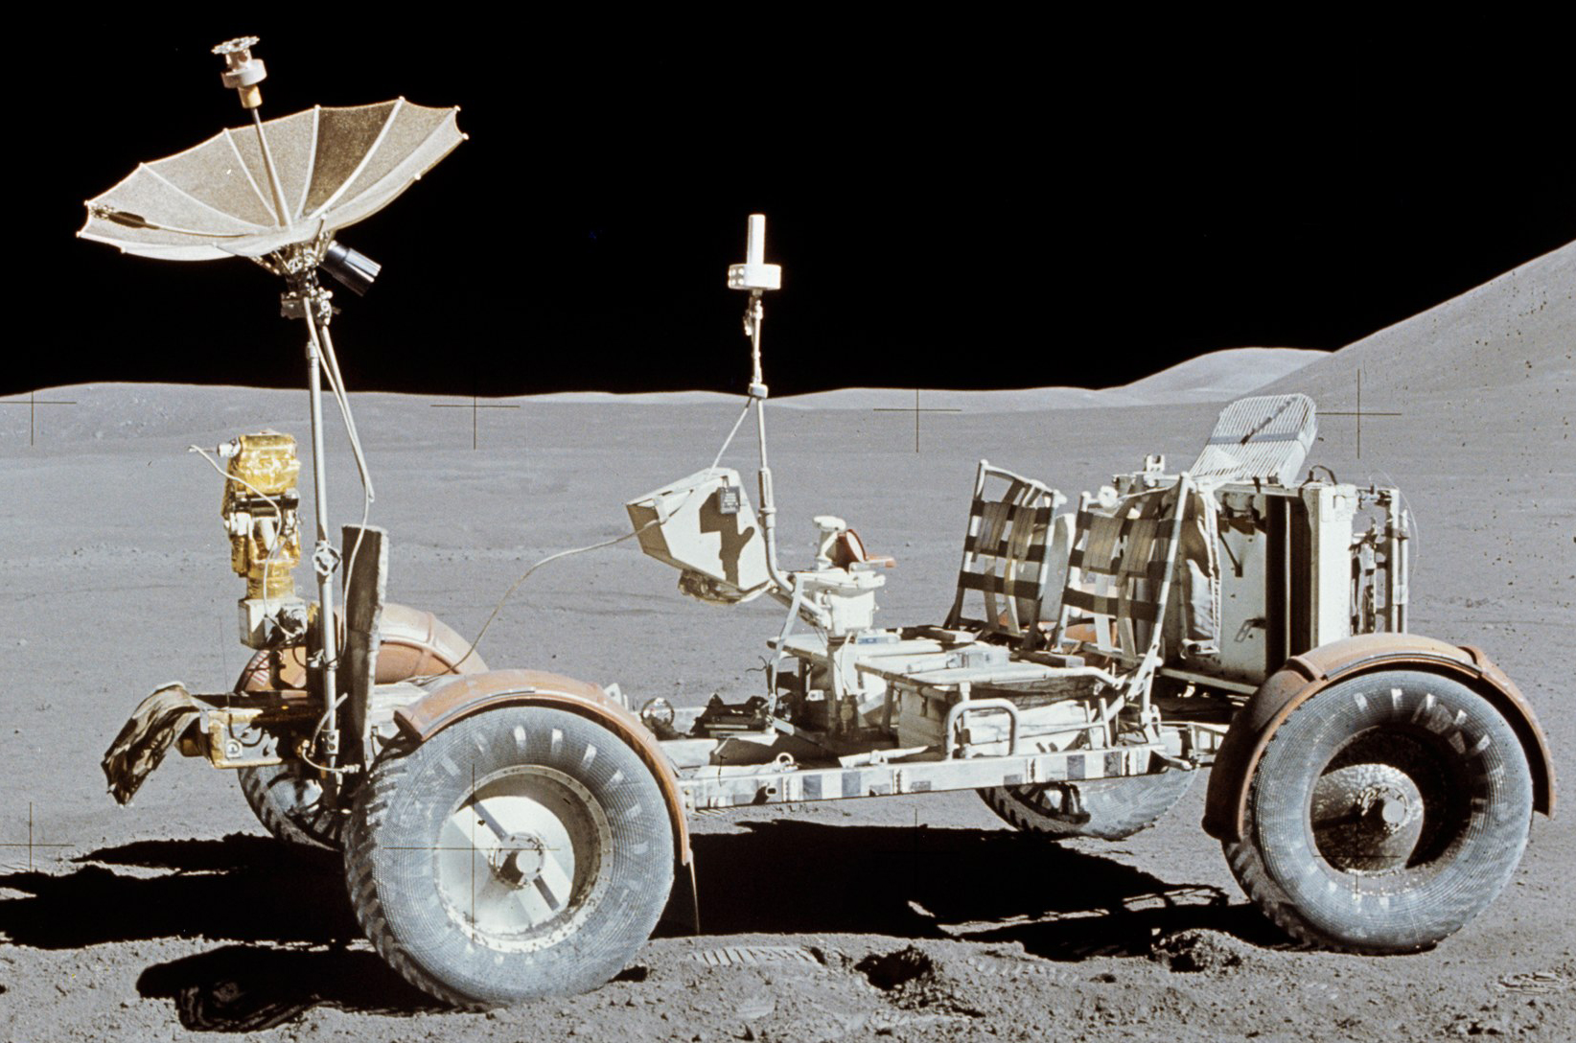
23CM EME PORTABLE

Slide 9
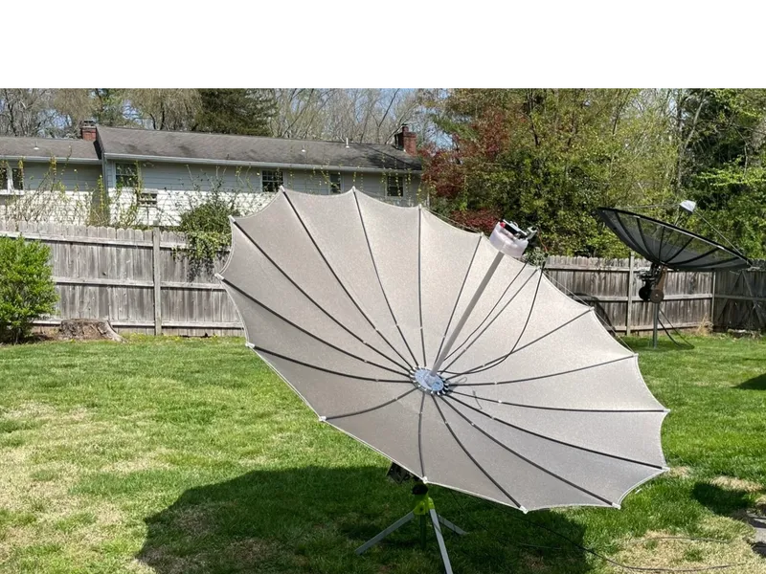

Slide 10
23CM EME PORTABLE
b
d
TX
IC-9700 / Transverter with combined TX/RX
TX/RX
NO
CO
NC
AMP
Coax
Switch
PTT
RX
TX
Seq
Coax
Switch
NO
CO
NC
LNA
RX
c
a

Slide 11
23CM EME PORTABLE
Transceiver
TX
Transverter with dedicated TX RX
AMP
RX
RX
TX
Coax
Switch
NO
CO
NC
LNA

Slide 12
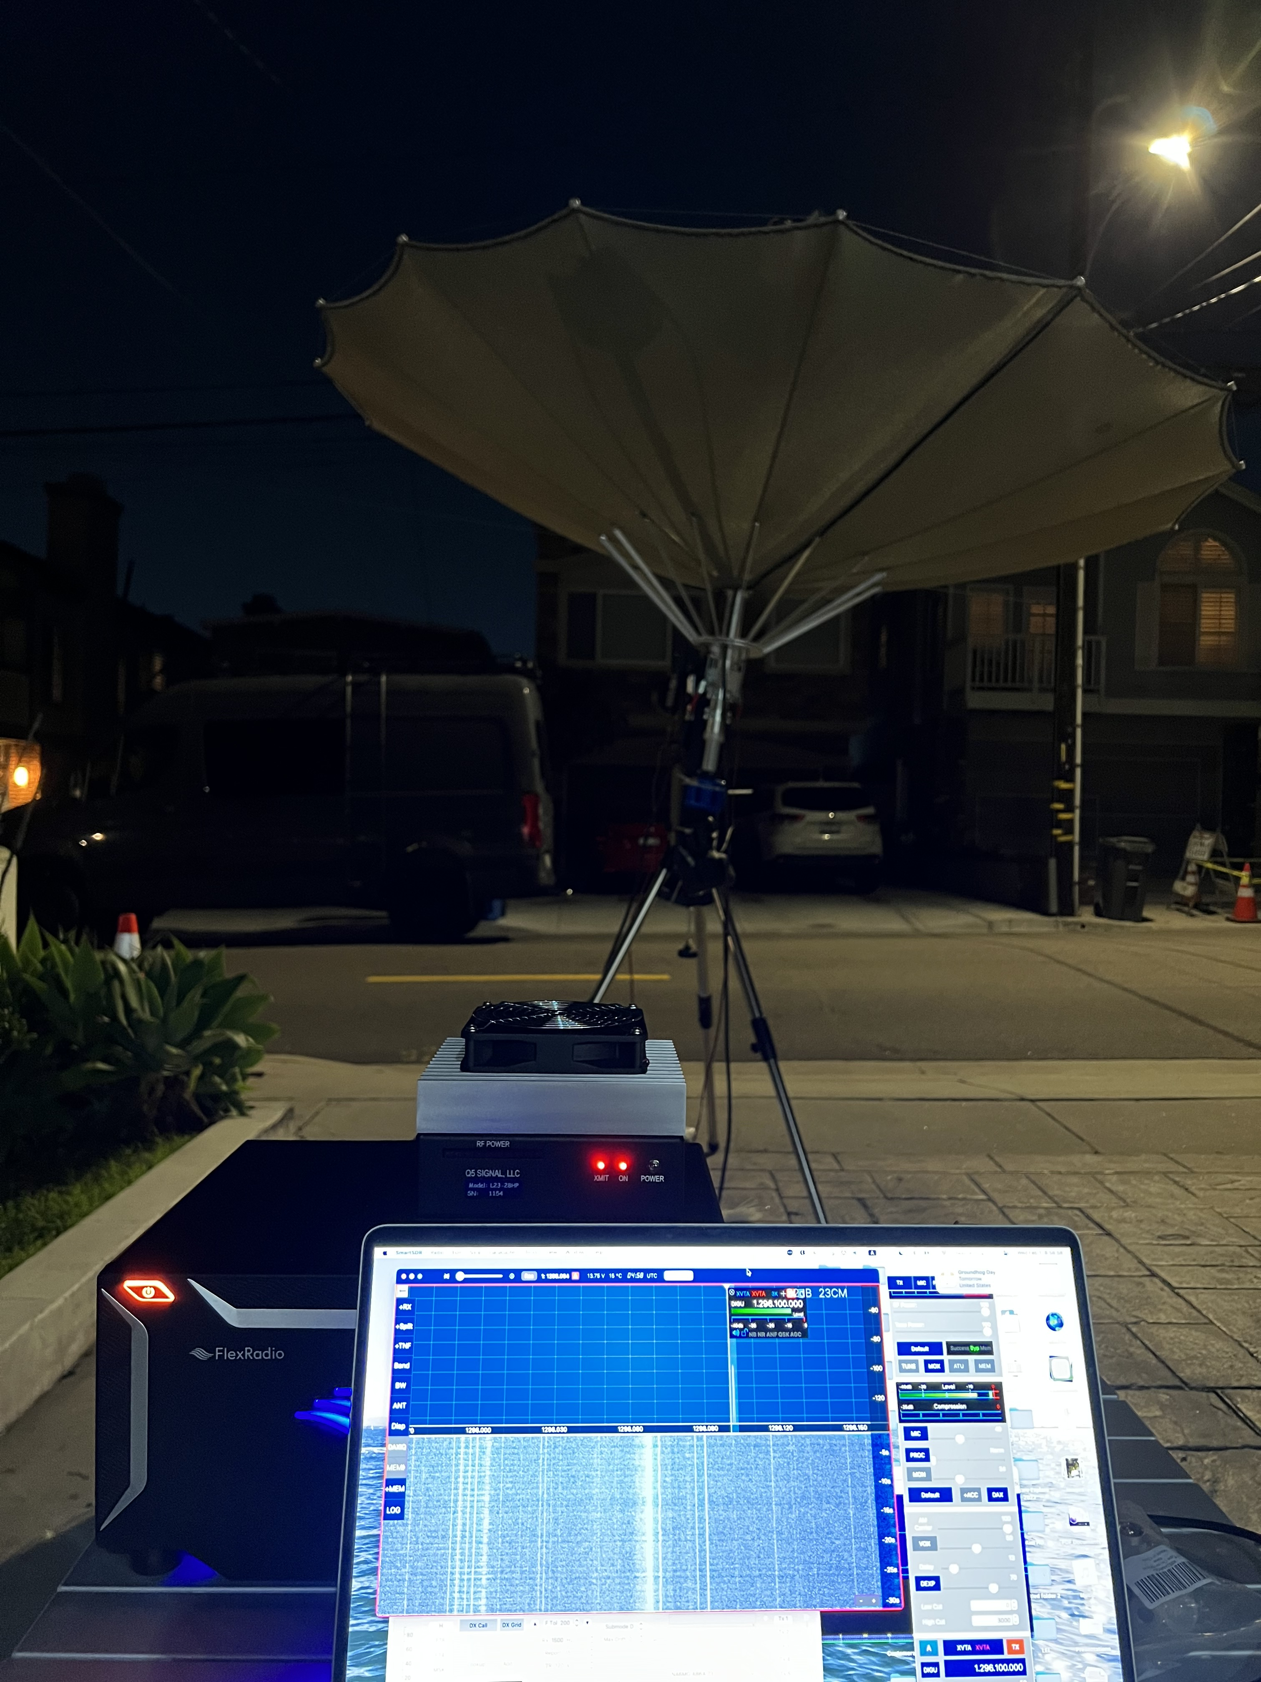
23CM EME PORTABLE
2.4M Dish Antenna
Rotator using an astronomy GOTO mount.
25W Transverter
Missing amp!

Slide 13
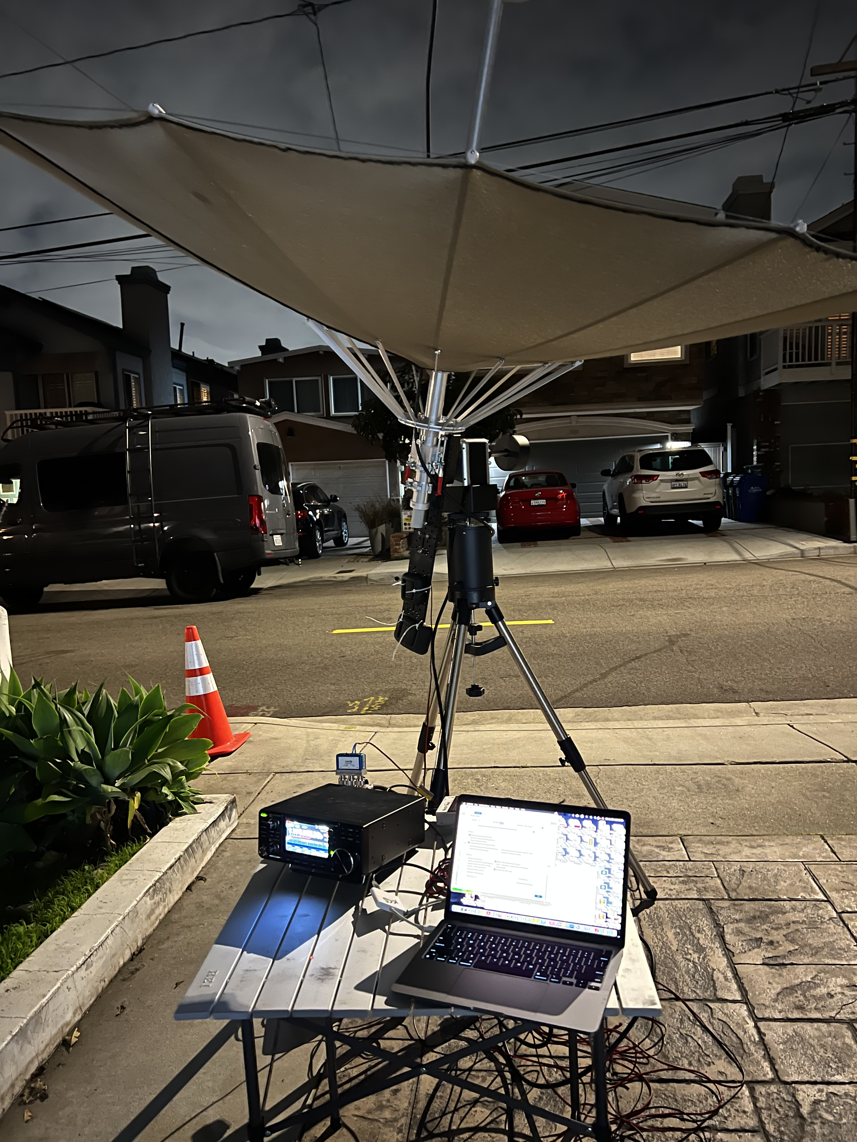
23CM EME PORTABLE
2.4M Dish Antenna
Rotator using an astronomy GOTO mount.
10W Transceiver
Missing amp!

Slide 14
Considerations
Reuse a satellite TV dish antenna. Just add a patch feed for 23CM.
Receive is easy and can be accomplished with an LNA and SDR at the Antenna patch feed, although need to consider doppler control.
LMR-240 for receive after LNA to transceiver.
LMR-400/600 from Amp to Patch Feed Transmit.
Transceiver/Transverter Time is Critical. GPSDO 10Mhz reference. For the Icom IC-9700, the Leo Bodnar reference mod is required together with a mini GPSDO time source set at 49.152MHz.
http://www.leobodnar.com/shop/index.php?main_page=product_info&cPath=107&products_id=352
Euro/UK dollar is good against the US Dollar. Many components including Amps are cheaper sourced from Europe.
250W Amp: https://thedxshop.com/product/linear-amp-gemini-23-1296mhz-200w-solid-state-linear-amplifier/
Sequencer: https://www.qskllc.com/uski-5
PTT Buffer for IC-9700: https://thedxshop.com/product/ptt-multiplier-for-icom-ic-9700/
Coax Switches: https://radiall-files.s3.amazonaws.com/tds/ramses/R570012000.pdf
Coax: https://abrind.com/shop/cable-builder/amateur-radio-coax-builder/

Slide 15
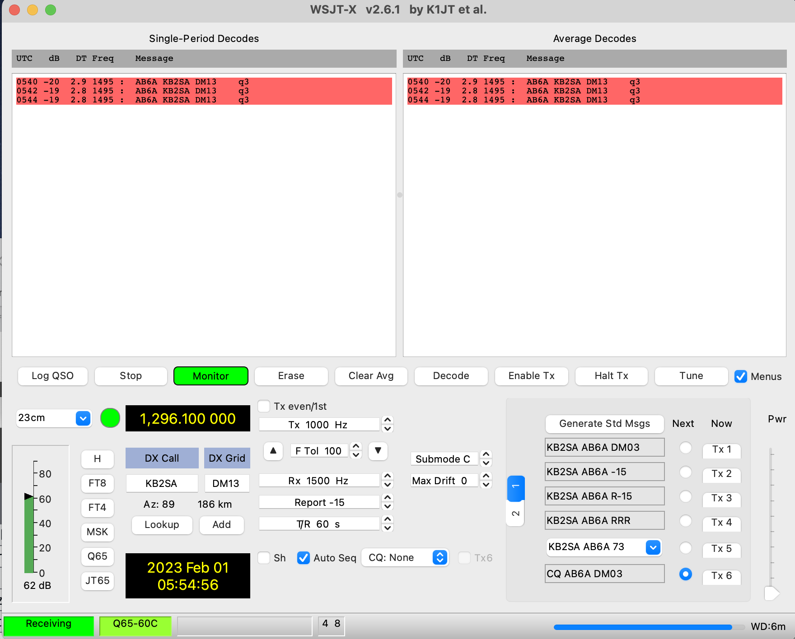
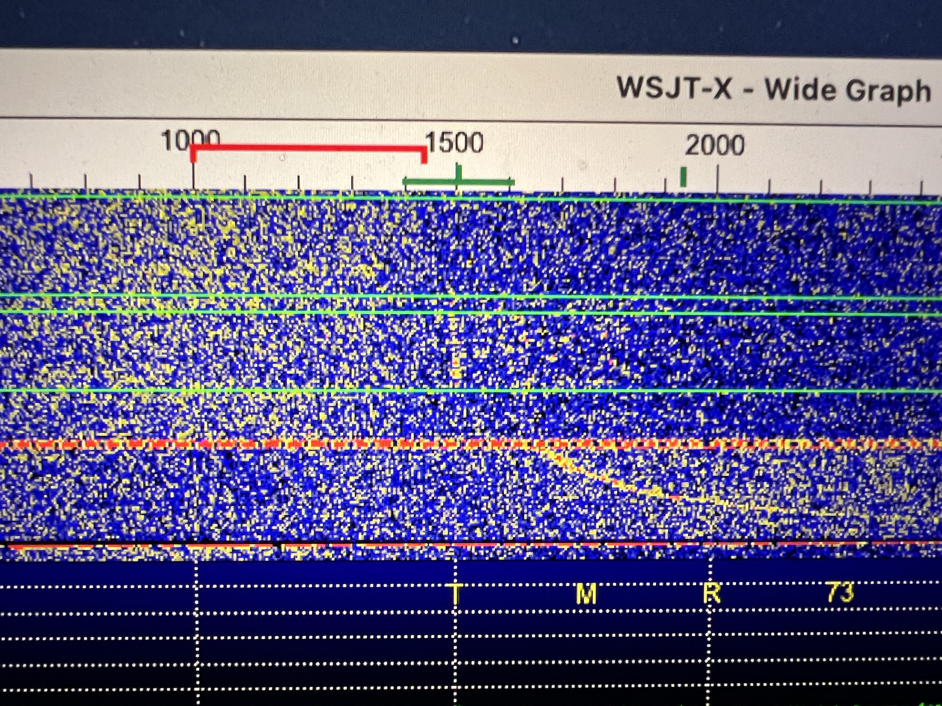
OPERATIONS… Q65
.65 but also .70 onwards to .100
T/R 30S – Submode B
T/R 60S – Submode C
T/R 120S – Submode D

Slide 16
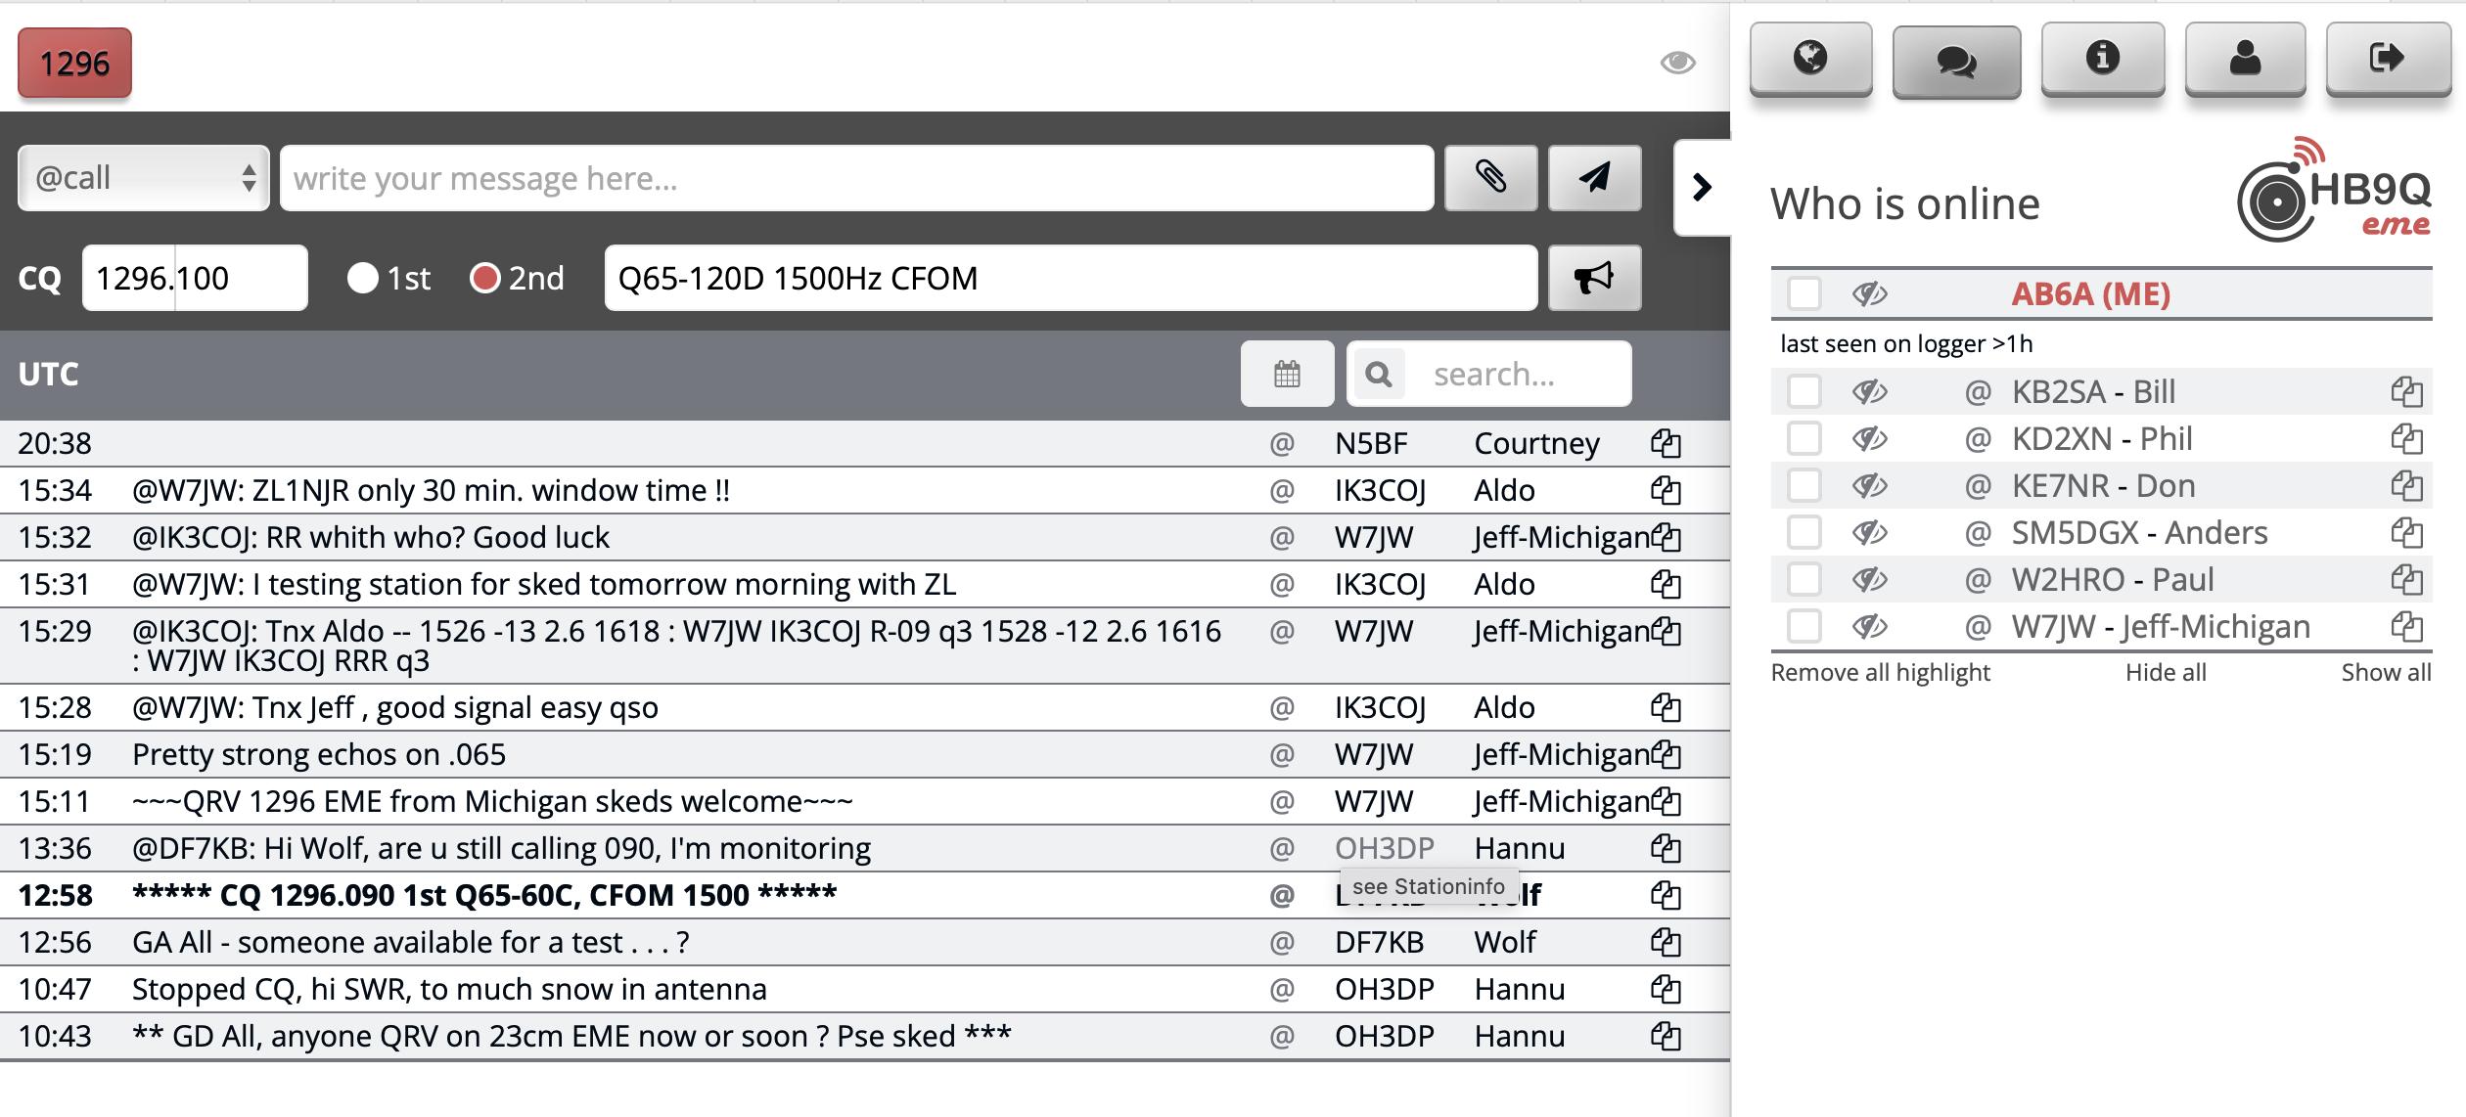
COORDINATION
https://logger.hb9q.ch

Slide 17
COORDINATION
https://logger.hb9q.ch

Slide 18
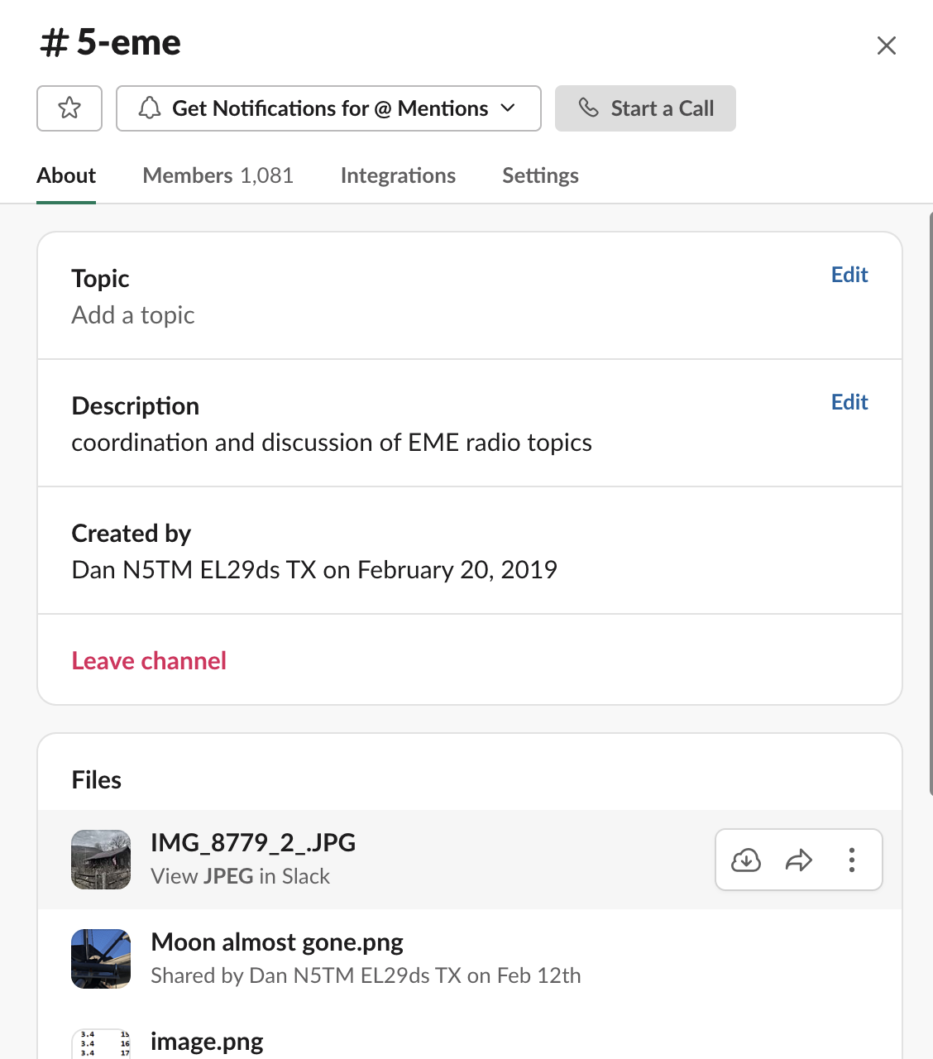
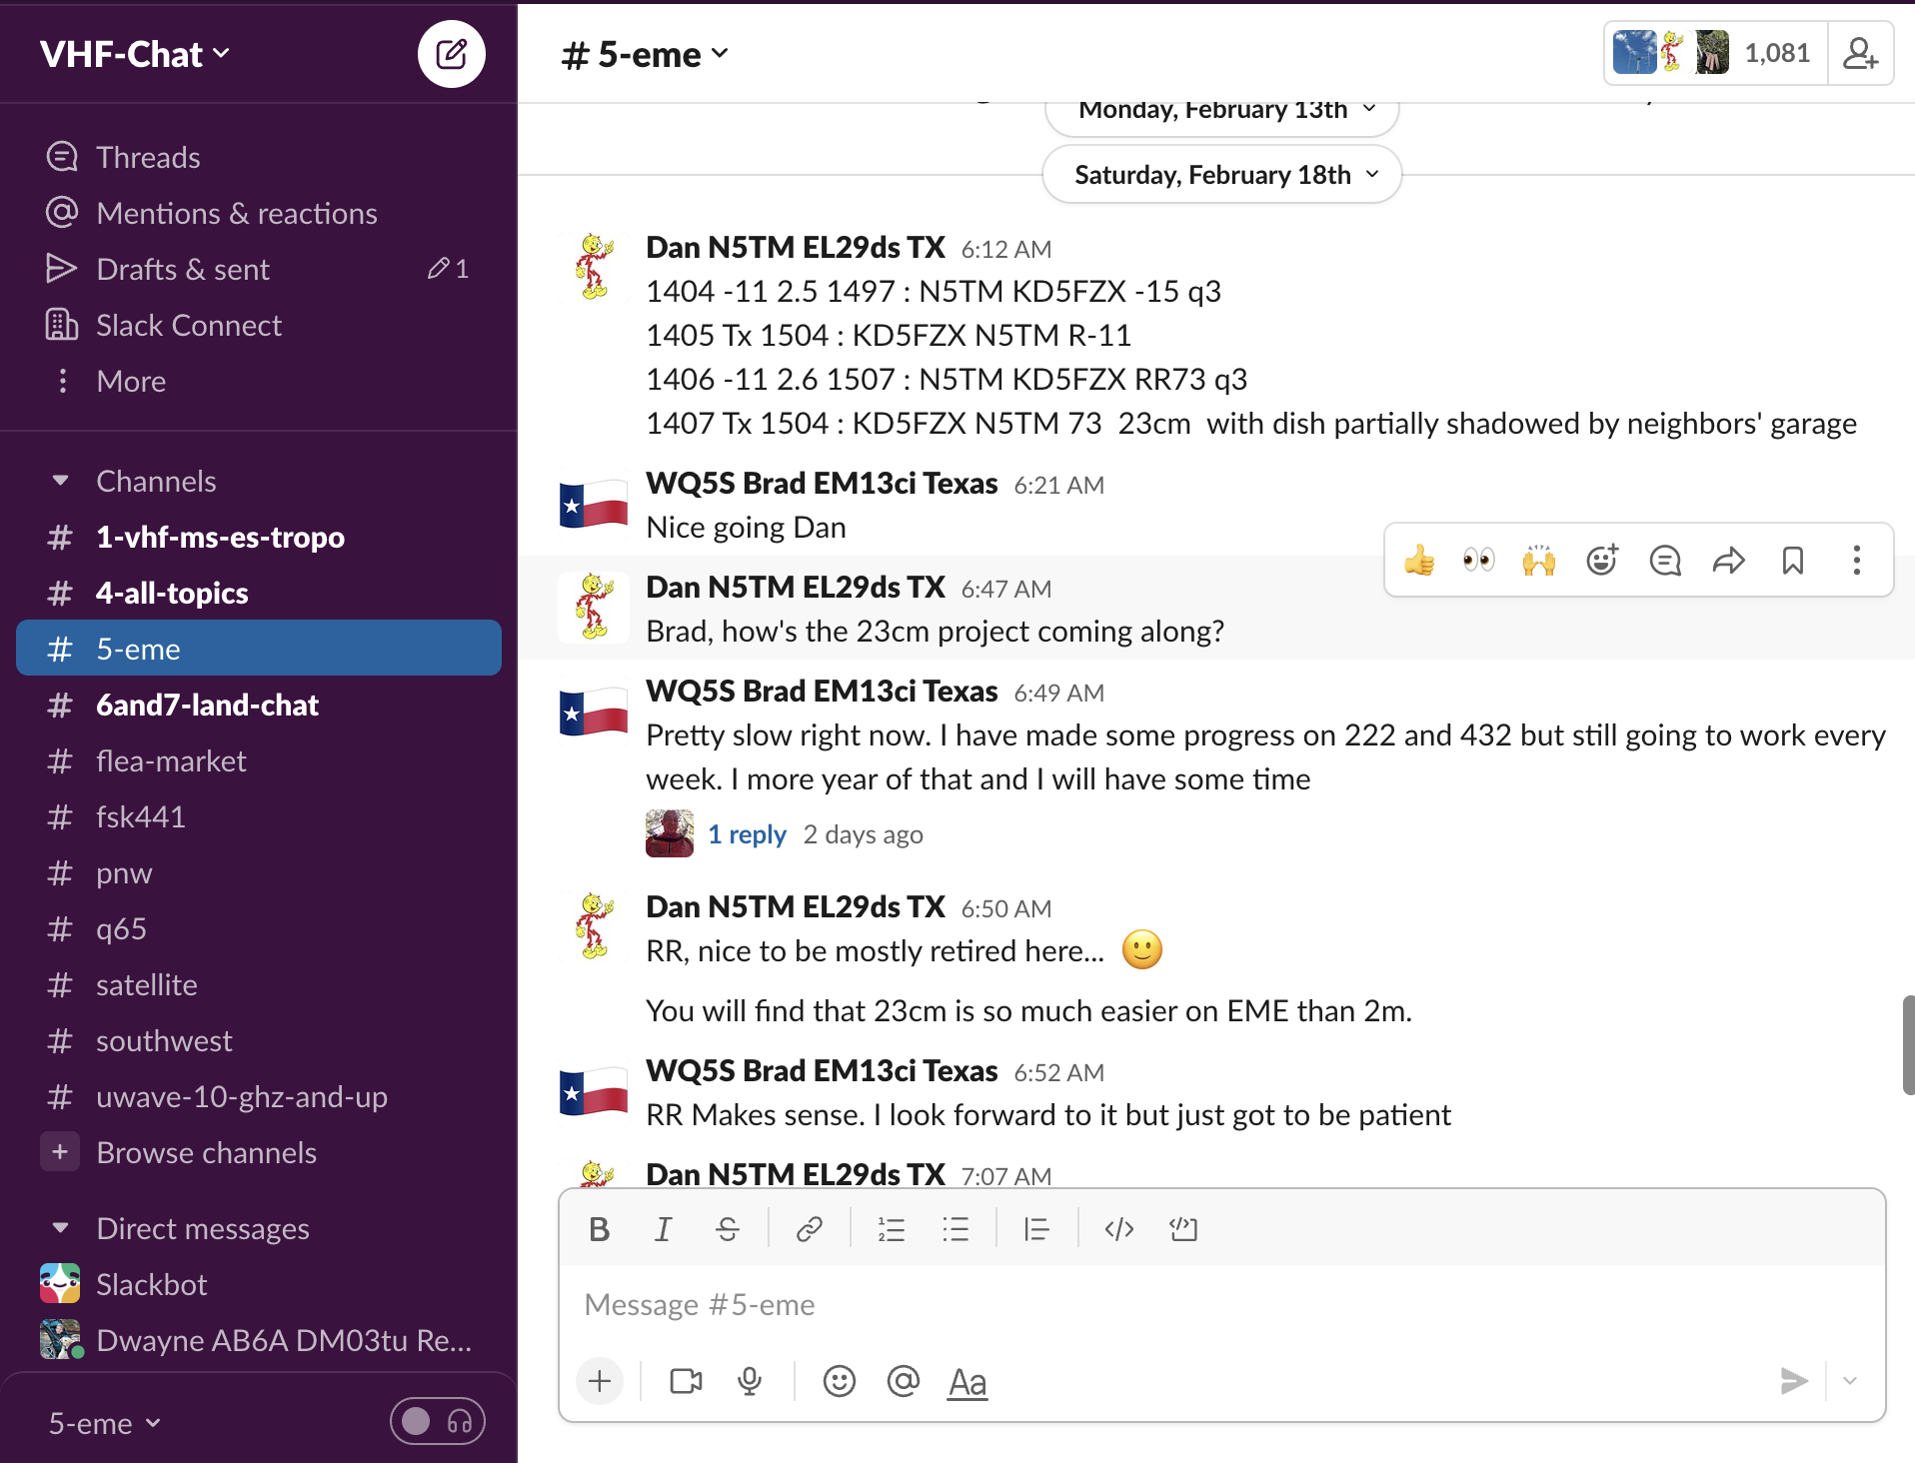
COORDINATION
Slack VHF Chat

Slide 19
Futures

Slide 20
Additional Info
EME Echo Doppler Spreading and Lunar Libration - http://www.bobatkins.com/radio/doppler_broadining_libration.html
Quick setup check for Q65 on 1296 EME - http://www.bobatkins.com/radio/Q65_1296_setup.html
Q65 - Choice of mode for 1296 EME - http://www.bobatkins.com/radio/q65_mode_selection.html
Measurement of Sun Noise - https://www.bobatkins.com/radio/sun_noise_measurement.html
Portable Dish Antennas - https://sub-lunar.com
Non Portable Dish Antennas - https://www.rfhamdesign.com/products/parabolicdishkit/19meterdishkit/index.php

Slide 21
THANK YOU
Dwayne Sinclair
(310) 849-2036
ab6a.us@gmail.com

